Slide 1
Lecture 10
Nick rugai phd

Slide 2
List vs Array
We have been calling lists arrays but they are not the same!
Let’s take a look at lists proper!

Slide 3
Lists as data structure
Developed in 1955-56 as an Efficient way of accessing, storing, and managing memory
In 1958 lisp is developed as the world's second high level language in order to take advantage of lists (fortran was the 1st)
Lists led to Data structure that leads to databases, internet indexing, and the world as we know of it!
Lists are the backbone of data structure

Slide 4

Lists are cool!
Lists are a collection of nodes of different type
List are mutable: they can shrink and swell
List are dynamically allocated at run time
Lists have supporting libraries so you don't have to write the code!

Slide 5
Lists are not too cool!
Cavalier memory allocation at run time is inefficient (vs. Static of strings)
As each node points to the next: pointers take up more memory
Long searchers because of the linear structure: if what is to know is the very last node, the search goes thru all the list!
Random of 'jumpy' memory access is not allowed in lists
If kept simple, lists are awesome!

Slide 6
Using lists review
sports = ['baseball', 'football', 'soccer', 'tennis']
arr = [2, 'stetson', 55.98, [3, 4]
empty = []
SEARCHING A NODE: sports [2] 'soccer'
BOOLEAN OPERATOR: 'basketball' in sports False
print (sports) ['baseball', 'football', 'soccer', 'tennis']
ADDING AT END: sports.append('polo')
sports ['baseball', 'football', 'soccer', 'tennis', 'polo']

Slide 7
Using lists review MORE METHODS
ADDING TWO LISTS:
sports2 = [‘swimming’ ‘rugby’]
sports.extend(sports2)
sports ['baseball', 'football', 'soccer', 'tennis', 'polo', ‘rugby’]
REMOVING:
del t[2:4] ['baseball', 'football', ‘rugby’]
t.remove(‘baseball’) ['football', ‘rugby’]
onesport = sports.pop(1)
onesport [‘football’]
sports [‘rugby’]

Slide 8
Using lists review MORE METHODS
MOST METHODS ARE VOID UNLIKE STINGS METHODS!
DO NOT ASSIGN A VARIABLE TO VOID METHODS!!!
sports2 = sports.sort() # WRONG!
sports.sort() //correct!

Slide 9
Using lists review FOR LOOPS
TRAVERSING: for i in range(len(sports)):
sports(i) = //whatever change desired
for x in sports:
print(sports) //if not change is desired
ADDING: numbers = [1, 2, 3, 4]
def add_all(numbers):
total = 0
for x in numbers:
total += x #equivalent to total = total + x
return total
sum(numbers) 10 //python gives you lots of already written methods

Slide 10
Using lists review FOR LOOPS
sports = [‘baseball’, ‘TENNIS’, ‘rugby’, ‘POLO’]
def capitalize_all(sports): #it will capitalize just the frist letter
res = []
for s in sports
res.append(s.capitalize())
return res
capitalize_all(sports)
for x in sports:
print(sports) [‘TENNIS’ ‘POLO’]

Slide 11
Using lists review FOR LOOPS
sports = [‘TENNIS’, ‘polo’]
def only_upper(t):
res = []
for s in t
if s.isupper():
res.append(s)
return res
print(sports) [‘TENNIS’]

Slide 12
Using lists review strings and list
s = ‘tennis’
t = list(s)
t [‘t’, ‘e’, ‘n’, ‘n’, ‘i’, ‘s’]
s = ‘tennis is boring!’
t = split()
t [‘tennis’, ‘is’, ‘boring’, ‘!’]

Slide 13
Using lists review strings and list confusions
s = ‘tennis’
t = ‘tennis’
s is t True
s = [‘tennis’]
t = [‘tennis’]
s is t False
u = [1,2,3]
u = s
u is s True //you have created two reference of the same object
//the object is aliased

Slide 14
Using lists review warnings
When you assign a variable to a list, the variable points to the list
If you pass the list to a function, the function also points to the list
The function can modify the list directly!
Most methods modify the list, most operators create a new list
s1 = [1,2]
s2 = s1.append(3)
s1 [1,2,3]
s2 none

Slide 15
Using lists review warnings
s3 = s1 + [4]
s1 [1,2,3]
s3 [1,2,3,4]

Slide 16
Lists vs. arrays
We’ve been also calling lists arrays but there is a difference.
True arrays in Python need to be imported:
import array
a = array.array('i', [1, 2, 3]) #integers
type(a)
b = array.array('d', [2.5, 3.2, 3.3]) #floats
b.insert(1,1.4)
b.append(4.4)
b

Slide 17
Lists vs. arrays
b.pop(1)
b
b.remove(2.5)
b

Slide 18
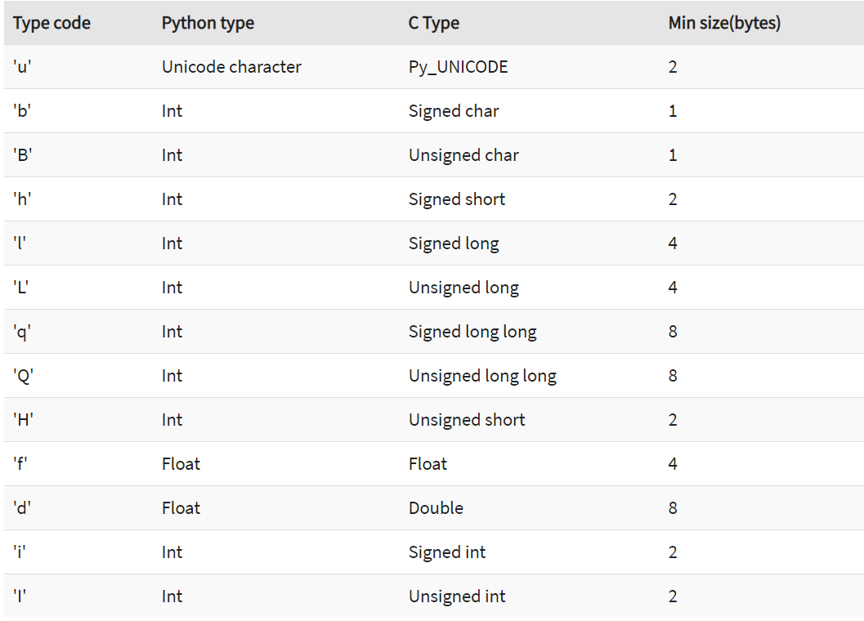

Slide 19
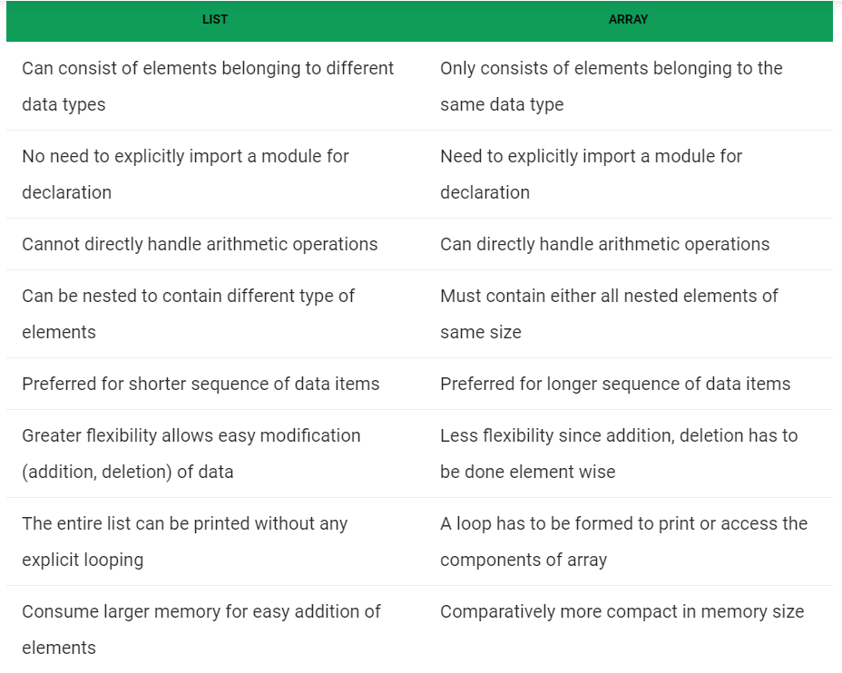
Lists vs. arrays

